Slide 1

Submitted by: SWETA(201600056) ABHISHEK KUMAR(201600057) MAYUR MAHANTA(201600491) PREETAM KALITA(201600489)
“BIG DATA AND HADOOP DATA ANALYSIS OF GENERAL ELECTION 2019 ”

Slide 2
INTRODUCTION
Big data is a big thing in the IT world.
Like many new information technologies,big data can bring about dramatic cost reductions,substantial improvements in the time required to perform a computing task,or new product and service offerings.
3 V's of Big Data are:
Volume
Velocity
Variety
The structure of Big Data are:
Structured
Semi Structured
Unstructured

Slide 3
Advantages of Big Data are:
Government
Manufacturing
Media
Technology
Science and Reasearch
Tools for Storing and Analysing Big Data
Apache hadoop
open source s/w framework
It has two basic parts:
1.HDFS(Storage)
2.MapReduce(Processing

Slide 4
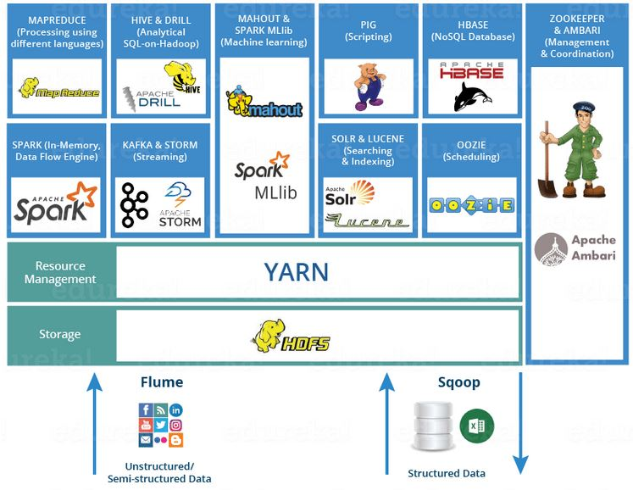

Slide 5
OBJECTIVE:
The only thing predictable about Indian Elections is that they are unpredictable.
Our objective is to analyse the general election result and know the incumbency of a party in particular areas.
Analysis of different aspects is also done to know the sentiments of people and to which party they are supporting in a particular state.

Slide 6
TECHNOLOGY USED:
HADOOP
HIVE
IMPALA
TABLEAU

Slide 7
DATA DICTIONARY:
State string
Pc string
Candidate string
Party string
evm_vote int
postal_vote int
total_vote double
percent_vote double
Rank int

Slide 8
PROBLEM STATEMENT:
Total number of EVM vote , postal vote and total number of votes casted in General Election.
Print the total number of seat won by all the parties.
Analyse total seat won by parties in state like rajasthan , madhyapradesh,punjab.
Analyse the vote percent of top 5 parties in Uttar Pradesh.
Find out top five candidate having maximum number of vote.
Top 10 parties to elect in maximum number of seats.
Top 10 Win by highest margin.
Top 10 Win by lowest margin.
Top 10 states to cast max number of postal votes.
Top 10 states to cast least number of postal votes.
Find top 10 states where there is least percentage vote shared by Bharatiya Janata Party.
Find top 10 states where there is maximum percentage vote shared by Bharatiya Janata Party.

Slide 9

IMPLEMENTATION
Q) Total number of EVM vote , postal vote and total number of votes casted in General Election . Plot the graph.
Select SUM(evm_vote) as EVM_VOTE,SUM(postal_vote) as POSTAL_VOTE,SUM(total_vote) as TOTAL_VOTE from project;

Slide 10
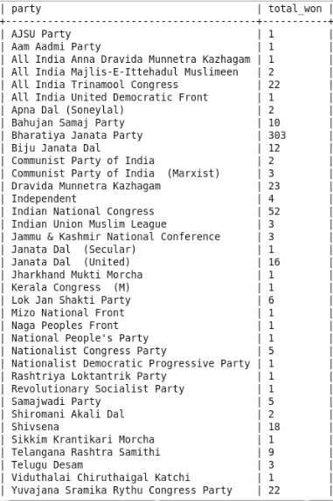
Q) Print the total number of seat won by all the parties.Plot the graph.
select party,count(*) as total_won from
project where rank=1 group by party;

Slide 11
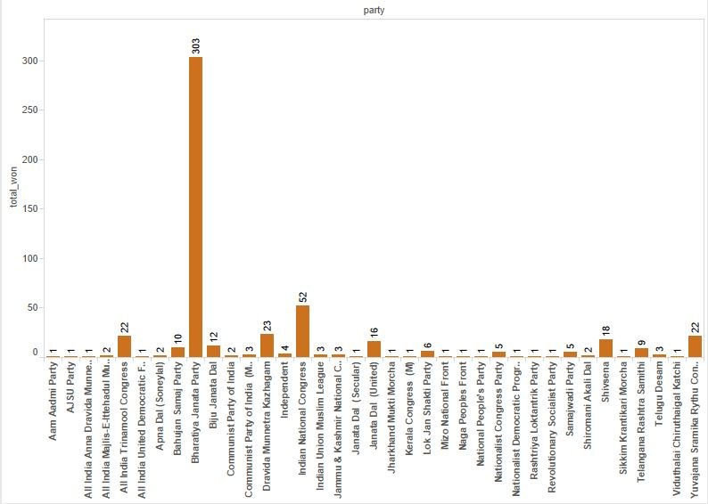

Slide 12
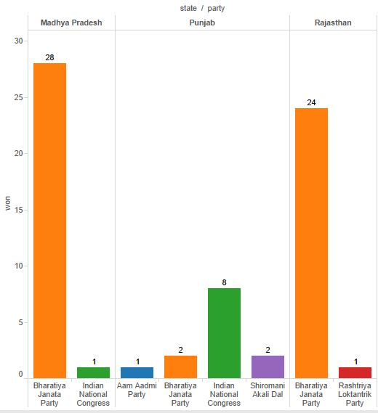
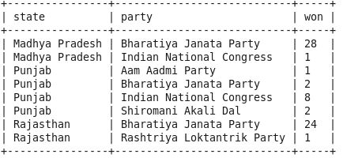
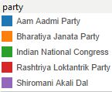
Q) Analyse total seat won by parties in state like Rajasthan , Madhya Pradesh, Punjab
select state,party,count(party) as won
from project where rank=1 and state
IN ('Rajasthan','Madhya Pradesh‘
,'Punjab') group by state,party order
by state limit 10;

Slide 13
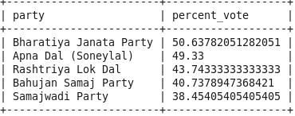
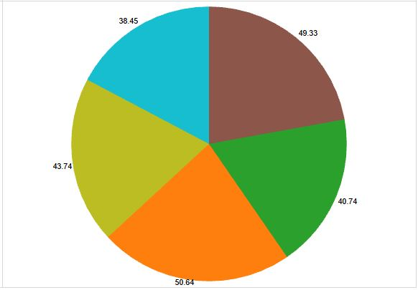
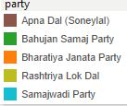
Q)Analyse the vote percent of top 5 parties in Uttar Pradesh
select party,avg(percent_vote) as percent_vote from project where state='Uttar Pradesh' group by party order by percent_vote desc limit 5;

Slide 14
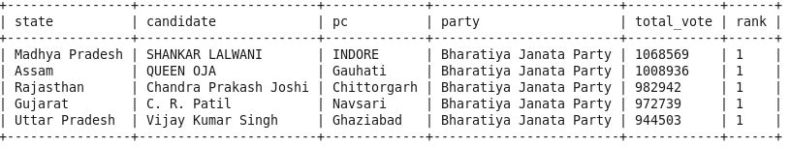
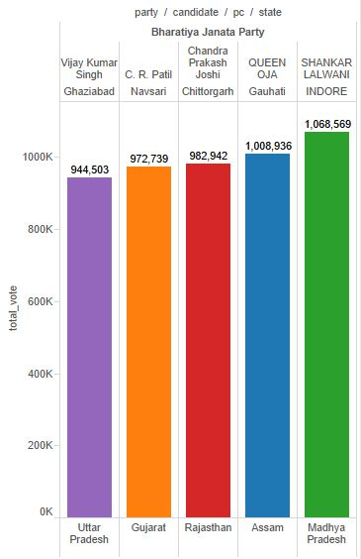
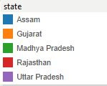
Q)Find out top five candidate having maximum number of vote
select state,candidate,pc,party,total_vote,rank from project where rank=1 order by total_vote desc limit 5;

Slide 15
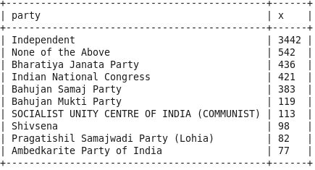
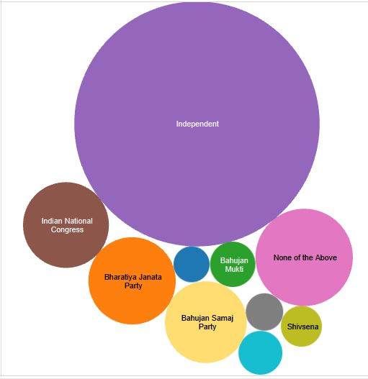
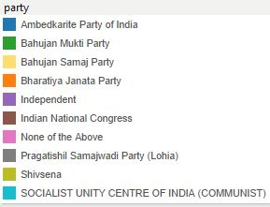
Q)Top 10 parties to elect in maximum number of seats.
select party,count(*) as x from project group by party order by x desc limit 10;

Slide 16
Q)Top 10 Win by highest margin
create table m1 as select state,pc,candidate,total_vote from project where rank=1 order by state;
create table m2 as select state,pc,candidate,total_vote from project where rank=2 order by state;
select m1.state as state,m1.pc as pc,m1.candidate as candidate,(m1.total_vote-m2.total_vote) as margin from m1 join m2 on(m1.pc=m2.pc) order by margin desc limit 10;

Slide 17
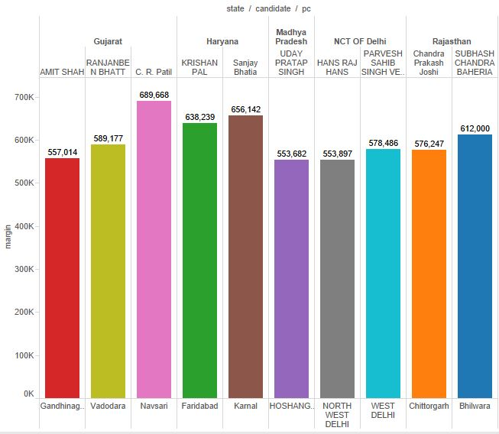
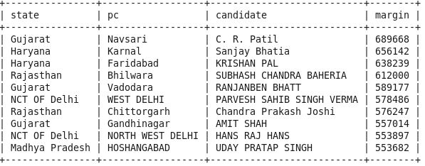
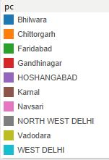
Q)Top 10 Win by highest margin

Slide 18
Q) Top 10 Win by lowest margin
create table m1 as select state,pc,candidate,total_vote from project where rank=1 order by state;
create table m2 as select state,pc,candidate,total_vote from project where rank=2 order by state;
select m1.state as state,m1.pc as pc,m1.candidate as candidate,(m1.total_vote-m2.total_vote) as margin from m1 join m2 on(m1.pc=m2.pc) order by margin limit 10;

Slide 19
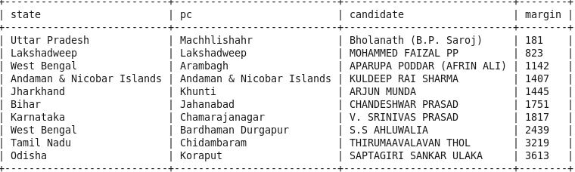
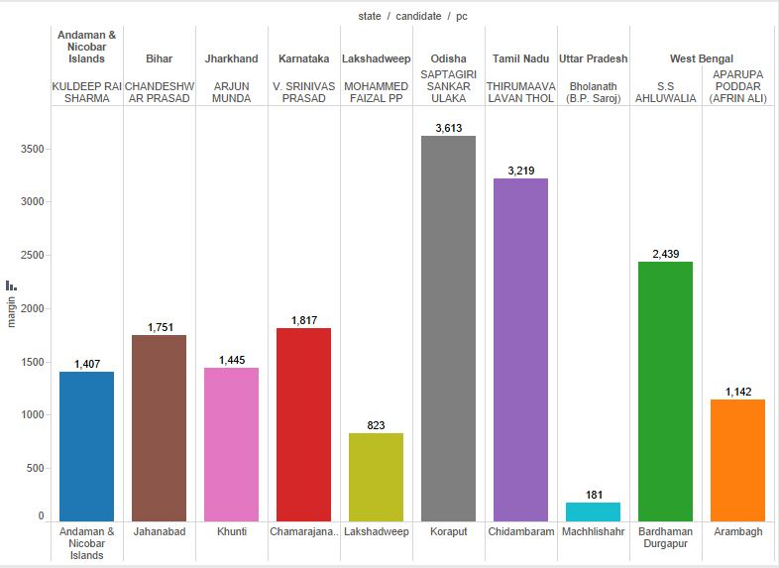
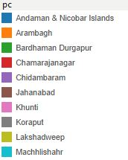
Q) Top 10 Win by lowest margin

Slide 20
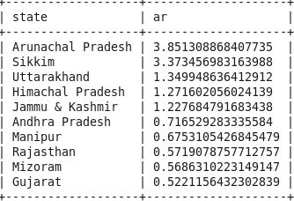
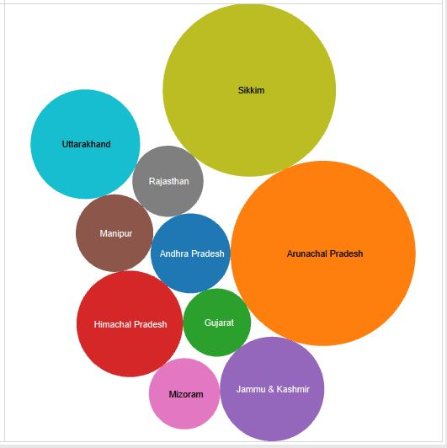
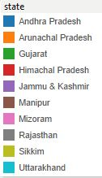
Q)Top 10 states to cast max number of postal votes
select state ,100*(sum(postal_vote)/sum(total_vote)) ar from project group by state order by ar desc limit 10;

Slide 21
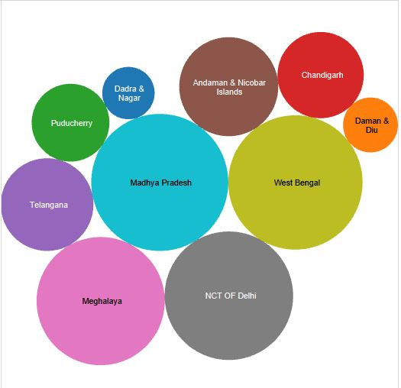
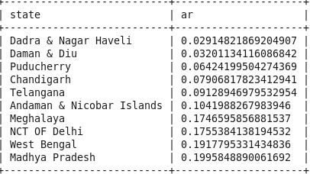
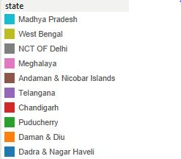
Q)Top 10 states to cast least number of postal votes
select state ,100*(sum(postal_vote)/sum(total_vote)) ar from project group by state order by ar limit 10;

Slide 22
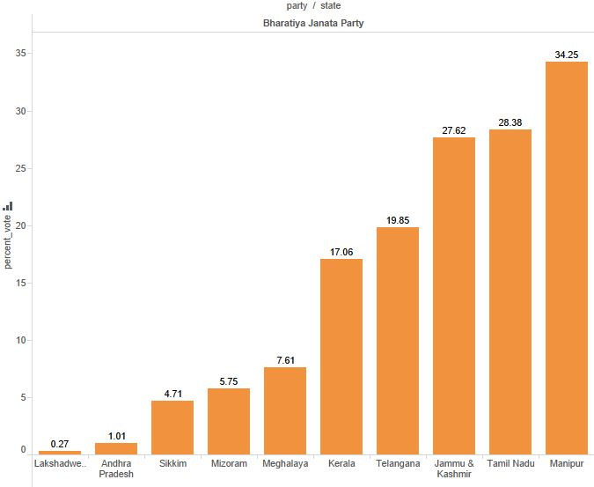
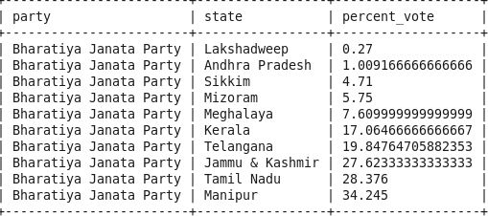
Q)Find top 10 states where there is least percentage vote shared by Bharatiya Janata Party
select party,state,avg(percent_vote) as percent_vote from project where party='Bharatiya Janata Party' group by party,state order by percent_vote limit 10;

Slide 23
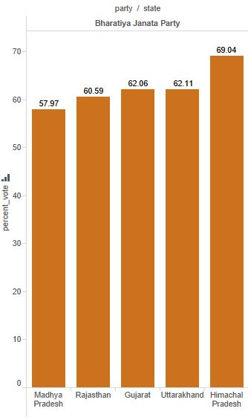
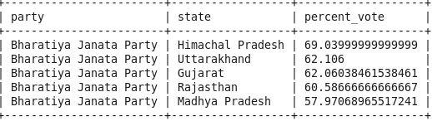
Q)Find top 10 states where there is maximum percentage vote shared by Bharatiya Janata Party
select party,state,avg(percent_vote) as percent_vote from project where party='Bharatiya Janata Party' group by party,state order by percent_vote desc limit 10;

Slide 24
Scope of the project:
The future scope of the project, i.e., the analysis of the Indian General Elections data set paves a path for further work that can be carried on to find and verifying the changed sentiments of the user before and after election. The study can be enhanced to actually classify the gender of the user and to match it with actual demographics it can include the scope for verifying whether the user is human or a robot. Other analysis suggests the count of votes received which helps in further enhancement of the system. With this project, we can also determine the statistics for the most popular party in the respective year and also focuses on analysis and report on specific details which would eventually help the census offer enhanced, accurate information that would incur several positive changes in the entire data analysis scenario.

Slide 25
THANK
YOU

